Slide 1
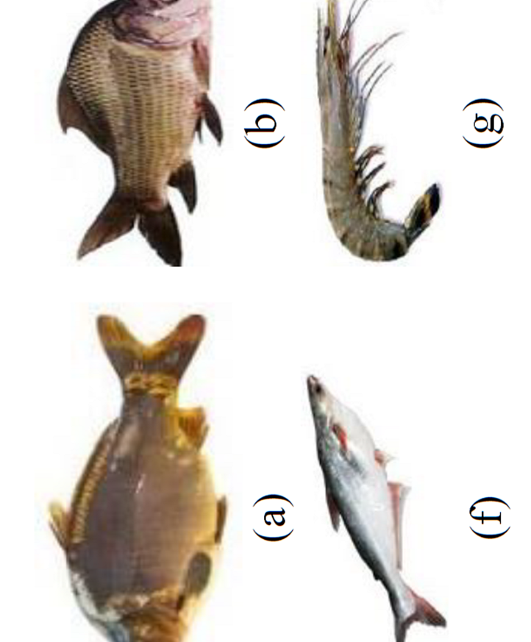
Fish Selection for Pond
Problem type: Classification

Slide 2

In the real world, it is very difficult for fish farmers to select the perfect fish species for aquaculture in a specific aquatic environment.
Without expert it is very difficult find which fish would do well in a pond
It takes to be a marine biologist and chemist together to select fish in specific water environment
Selecting wrong fish for farming can lead to a catastrophe sometimes
Problem Statement
How to Select Fish for Specific Pond Environment
Decide which fish will grow well
What needs to change in the pond water to farm certain fish

Slide 3

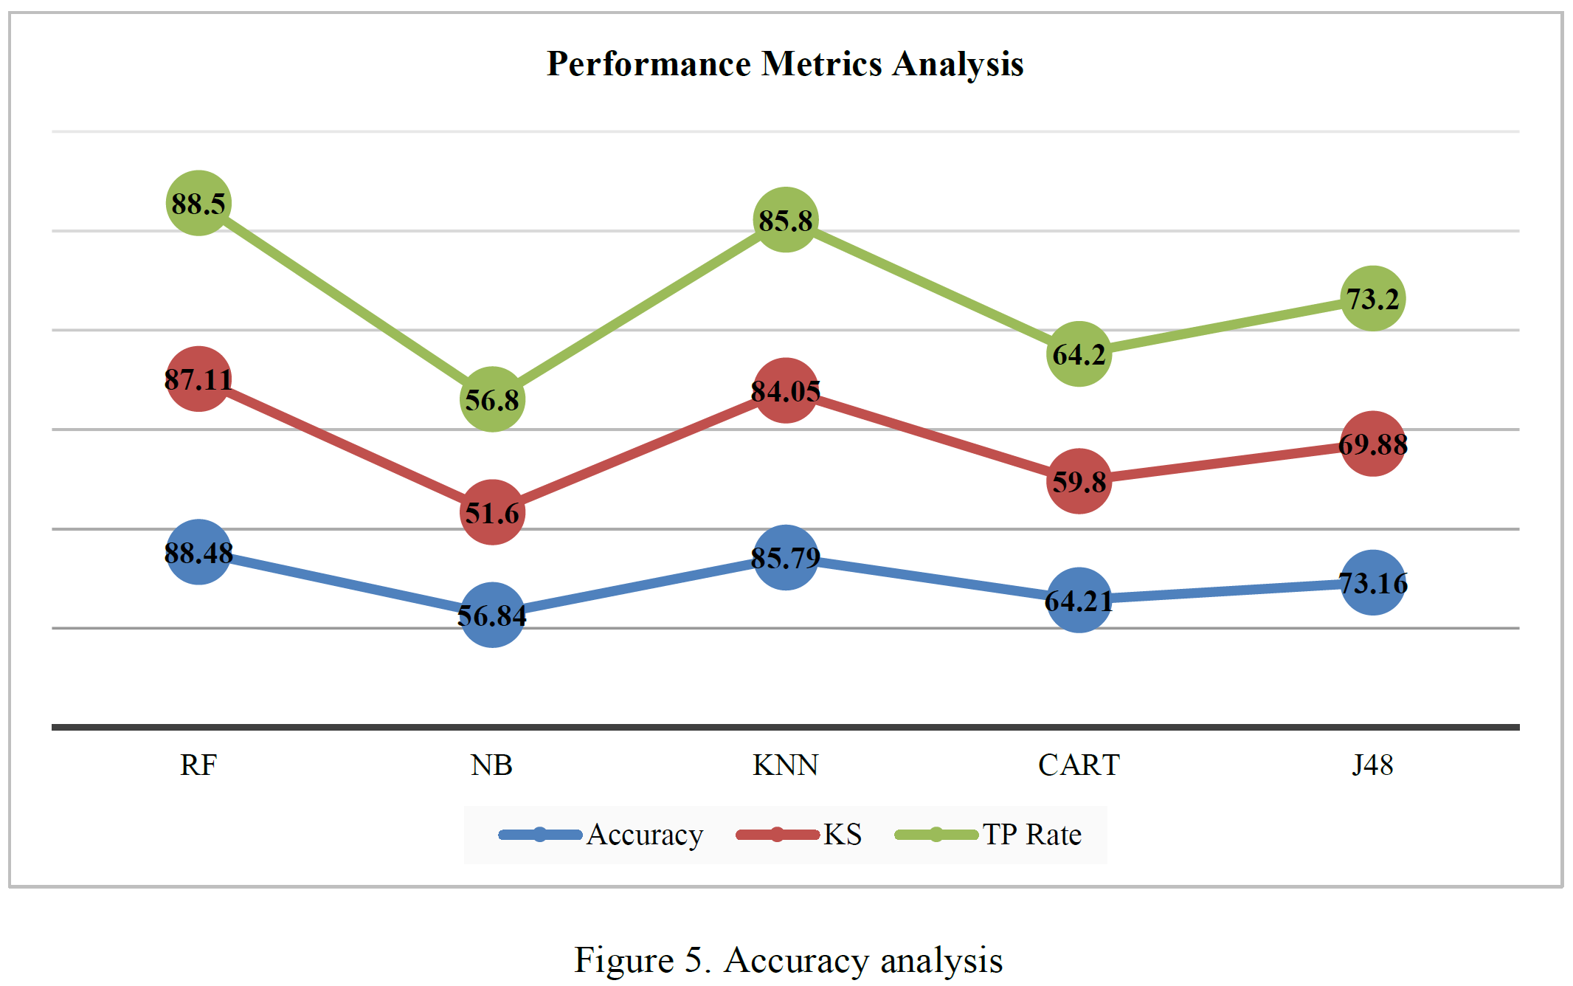
Target: Find fish type based on water quality
Duplicate Sampled Data
Description
Process: Duplicate Sample injected to train better, but improvement is not reported
Result: The result include In sample (90%, 510 rows of) and out of sample 20 rows of data (10%)
Further, the research scope can be defined by enriching the dataset by more observation and testing with artificial neural network

Slide 4

The Data Set

Slide 5

So lets Run with a Robot AI…..

Slide 6
Get the Resource planning decision with 4 steps
Login
Name Project “Project 1”and Solution Name “Car Sales Decision”→ Version 1.0→ Click create project
Data
Build Model
You will land inside Data tab click on “Add Data”
Name your data “” → Click on source→ select CSV → A data upload panel will pop up
Browse your computer to upload example_0_car_price_train_data.csv file
A variable list will show up→ click on skip
Select target. Choose “price” as your target
A window will pop up asking you run the preliminary analysis or not. Press Yes Button
Preliminary analysis will run-→see result in Predicted Price chart and Prediction KPI for error
Press Next→ land in “build Model page
Select Variables
Uncheck variable 1,2,3
Select Algorithm
Linear Regression
Random Forest
XGBoost
Click on Train
Click on Finalize
You will land on Deploy page

Slide 7
Get the Mr. X’s decision with 4 steps
Deploy
Decision
Click on Add data→
upload new data from CSV source from you computer example_0_car_price_pred_data.csv file
A variable list will show up→ click on skip
Go to Data Post Process
Create 3 equation by clicking pn create custom variable
Equation 1 Apply
Equation 2 Apply
Equation 3
Go to Result Configuration
Check download as CSV
Select Algorithm
Linear regression
XGBoost
Press “Predict”, prediction will running
Press Next→ you will land in Decision Page
Select Decision Scenario Tab
Change slider value for different variables
Press Apply
Do the step until Target or Target desired value is higher or lower or middle

Slide 8


Slide 9
Science based variable
Karpio_opt = np.where((df["temperature"]>22) & (df["temperature"]<27) , 1 , 0)
Katla_opt = np.where((df["temperature"]>25) & (df["temperature"]<30) , 1 , 0)
Bighead_opt = np.where((df["temperature"]>22) & (df["temperature"]<32) , 1 , 0)

